Slide 1
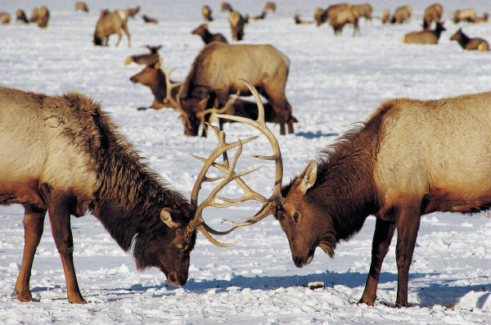
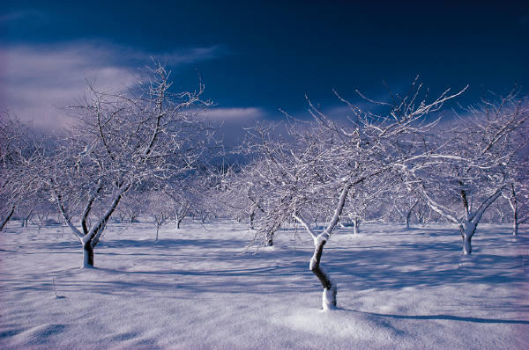
Sun gives plants energy for photosynthesis which creates oxygen.
Oxygen goes through atmosphere.
Animals breath in O2.
Plant breaths in CO2; breathes out O2

